Slide 1

iFood CRM Data Analyst case
Notes:
Line spacing + Page numbers

Slide 2
Agenda
01 Description
02 Preprocessing
03 Questions and Answers
04 Dashboard

Slide 3
Description
01
A food company wants to produce the highest profit for the next direct marketing campaign , scheduled for the next month.
A pilot campaign 2.240 customers was carried out , customers who bought the offer were properly labeled. The total cost of sample campaign was 6.720MU and the revenue generated by the customers who accepted the offer was 3.674MU

Slide 4
Preprocessing
02

Slide 5
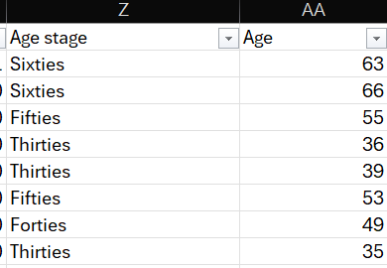
Remove duplicate rows
Add age stage column according to age column

Slide 6
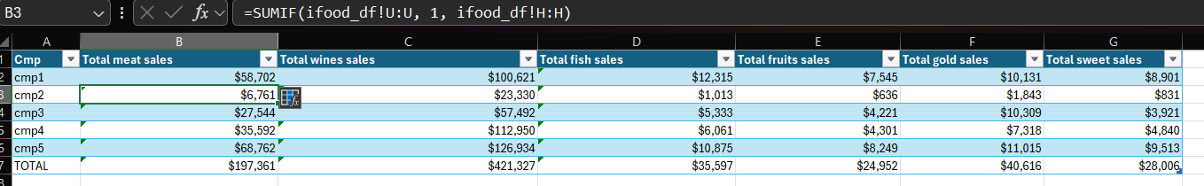
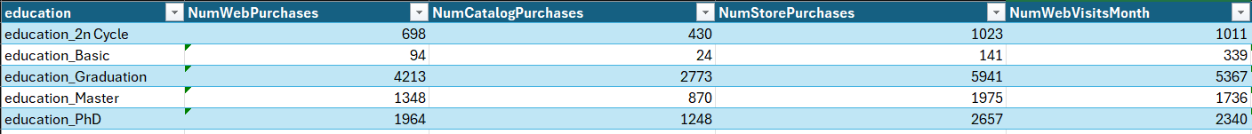
3. Create table for analyzing sales performance across different products and companies, allowing for comparisons and insights into total sales in various categories.
4. Create table for analysis of purchasing behavior and web activity across different educational backgrounds, highlighting trends in e-commerce and consumer engagement based on education level.

Slide 7
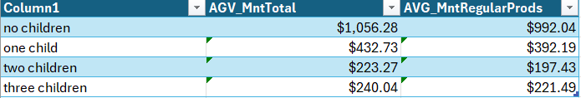
5. Create table for help in understanding consumer behavior and spending habits based on family size, which might be useful for marketing strategies and business planning.

Slide 8
Questions and Answers
03

Slide 9
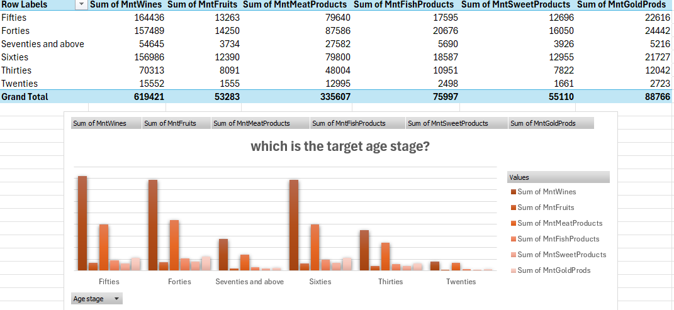
Q1: Which age stage shows the highest expenditure across various product categories?
The Fifties age stage shows the highest expenditure across multiple product categories, particularly in the following ways:
Wines: $164,436
Fruits: $13,263
Meat Products: $79,640
Fish Products: $17,595
Sweet Products: $12,696
Gold Products: $22,616
In total, this age group leads in spending, with a grand total of $619,421 across all product categories. This indicates that the Fifties demographic is the target age stage for marketing and sales strategies focused on these products.

Slide 10
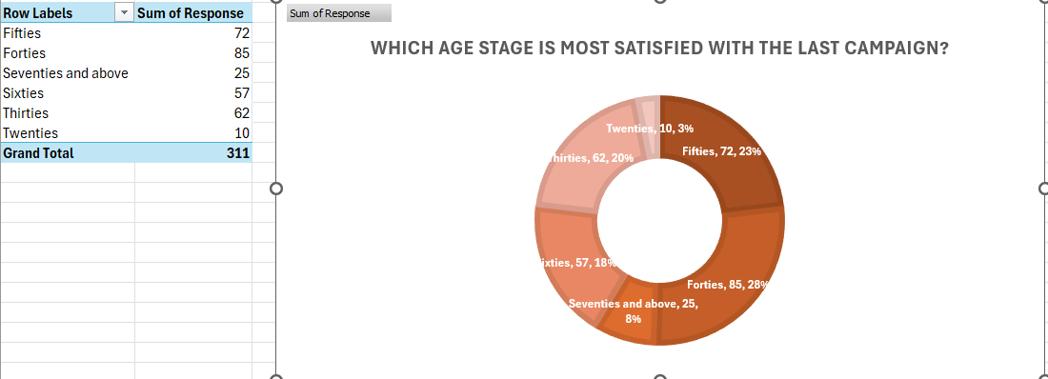
Q2: Which age stage is most satisfied with the last campaign?
The Forties age stage is the most satisfied with the last campaign, receiving the highest number of responses at 85, which accounts for 28% of the total responses. Other notable age stages include:
Fifties: 72 responses (23%)
Thirties: 62 responses (20%)
Sixties: 57 responses (18%)
Seventies and above: 25 responses (8%)
Twenties: 10 responses (3%)
This data indicates that the Forties demographic shows the greatest satisfaction regarding the campaign, making it a key target group for future marketing efforts.

Slide 11
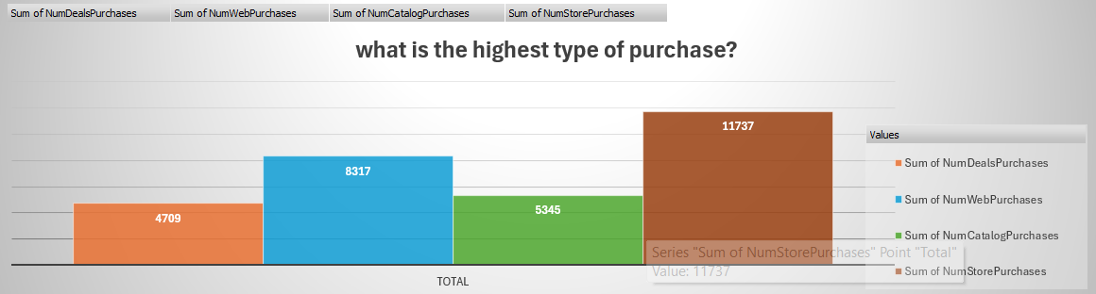
What is the highest type of purchase?
Answer:
The highest type of purchase is Store Purchases, totaling 11,737. The breakdown of purchase types is as follows:
Store Purchases: 11,737
Web Purchases: 8,317
Catalog Purchases: 5,345
Deals Purchases: 4,709
This data indicates that consumers prefer making purchases in-store compared to other channels, highlighting the importance of physical retail in the purchasing process.

Slide 12
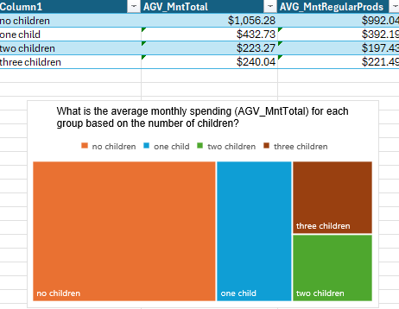
What is the average monthly spending (AGV_MntTotal) for each group based on the number of children?
Answer:
The average monthly spending (AGV_MntTotal) for each group based on the number of children is as follows:
No Children: $1,056.28
One Child: $432.73
Two Children: $223.27
Three Children: $240.04
This data shows that households without children have the highest average monthly spending, while those with two children have the lowest, indicating a potential correlation between the number of children and monthly expenditure.

Slide 13
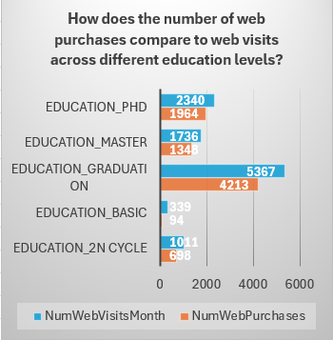
How does the number of web purchases compare to web visits across different education levels?
The chart compares the number of web purchases to web visits per month across various education levels. Here’s a summary of the findings:
Education_Phd:
Web Visits: 2,340
Web Purchases: 1,964
Education_Master:
Web Visits: 1,736
Web Purchases: 1,348
Education_Graduation:
Web Visits: 5,367
Web Purchases: 4,213
Education_Basic:
Web Visits: 339
Web Purchases: 94
Education_2n Cycle:
Web Visits: 1,011
Web Purchases: 698
Observations:
The Education_Graduation group has the highest number of web visits and purchases, indicating a strong correlation between education level and online shopping behavior.
Conversely, the Education_Basic group has the lowest numbers in both categories, suggesting less engagement with web purchases.
Overall, higher education levels tend to show a greater number of web visits and purchases, highlighting a potential trend in consumer behavior based on education.

Slide 14
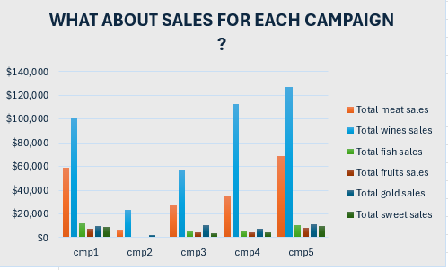
What are the sales figures for each campaign across different product categories?
The chart displays sales figures for five different campaigns (cmp1 to cmp5) across various product categories
Campaign 4 shows the highest sales overall, particularly for meat and wines.
Campaign 5 also performs well, especially in fish and sweet product sales.
Campaigns 1, 2, and 3 generally have lower sales figures across all categories compared to Campaigns 4 and 5.
This data suggests that Campaigns 4 and 5 were more effective in generating sales across multiple product categories.

Slide 15
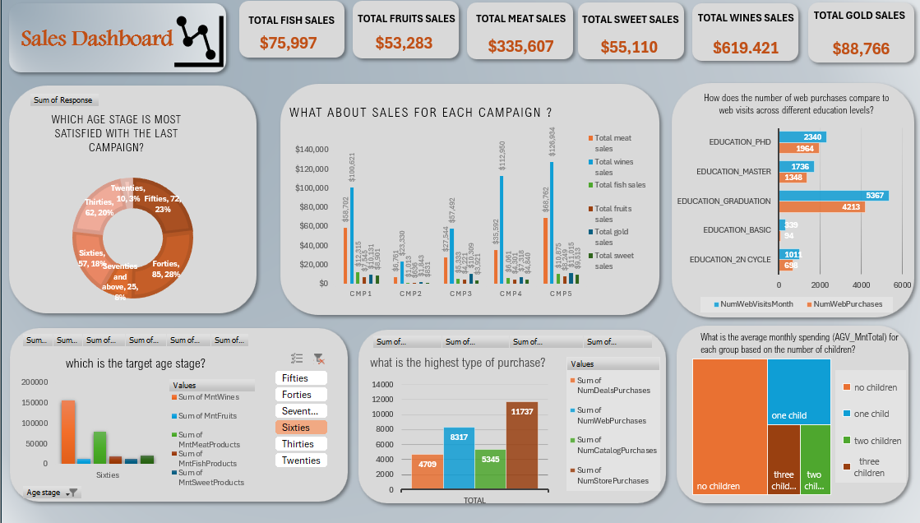
LINK : shroukelhosiny/data_analysis (github.com)

